Slide 1

Blockchain
Sunitha R
Department of Computer Science and Engineering

Slide 2

Blockchain
DECENTRALIZED AUTONOMOUS ORGANIZATIONS (DAOS)
Sunitha R
Department of Computer Science and Engineering

Slide 3
Blockchain
DAOs
DAOs can now be used to do a lot more when applied to the idea of traditional organizations.
For example, they could be used for voting for a new government, or by shareholders in a public or private corporation irrespective of the size.
The Bitcoin network is considered to be a DAO.
It allows any person to join in the creation and security of the system and cooperation is completely voluntary.
The rules for the network are held within its consensus protocol, and the miners vote by choosing what blocks to build on.

Slide 4
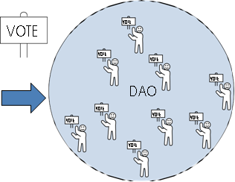
Blockchain
DAOs
Figure. The owners of the DAO vote on proposals.

Slide 5
Blockchain
HOW DAOs WORK?
DAOs run through rules encoded within their smart contracts.
They live completely online but can govern assets that are offline, like real estate or natural resources.
DAOs allow two parties that have never met to cooperate and make decisions on a thing of value that they both share an interest in maintaining.
DAOs enable these individuals to do things like hiring other individuals to perform tasks that can’t be automated.
Many DAOs have hired individuals to develop software, for example.
DAOs rely on tokens to gain cooperation.

Slide 6
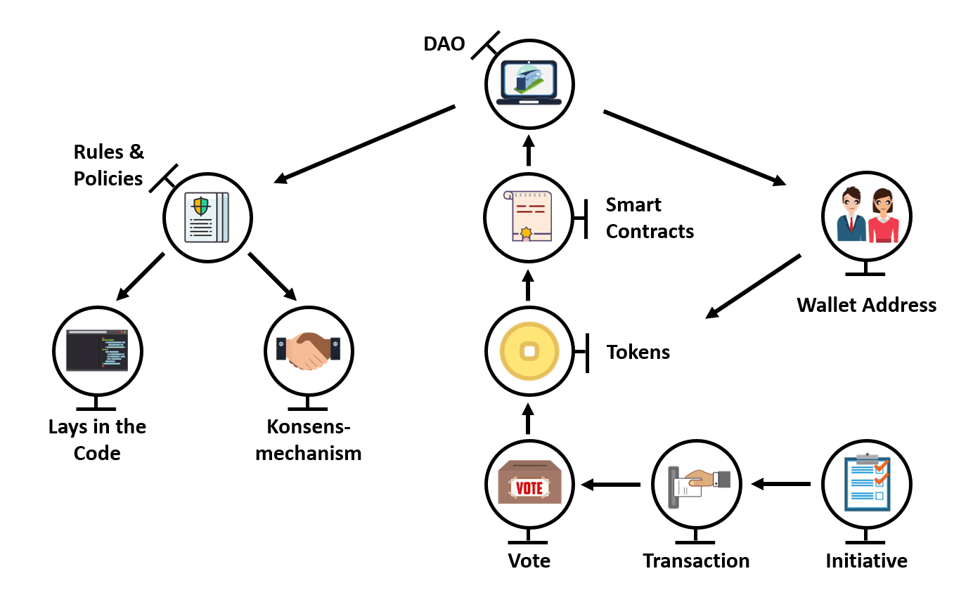
Blockchain
HOW DAOs WORK?

Slide 7
Blockchain
KEY TAKEAWAYS ABOUT DAOs
All a DAO’s transactions are a record within its blockchain.
The transparency in accounting and financials lets the code act as the accepted, trusted third party.
DAOs gain consensus by having their members vote on important issues such as the withdrawal or movement of funds.
A majority of its stakeholders specified in the smart contract must agree on all decisions.
Many smart contracts give voting windows so that proposals and actions are not held up by nonresponsive members.

Slide 8
Blockchain
LEGALITY OF DAOs
The code and capabilities of DAOs do not absolve individuals from complying with regulations and laws.
If you are thinking about creating a DAO, seek legal counsel.
Many countries have begun to create a legal framework that allows for the unique nature of DAOs.
For example, Malta created a legal framework for DAOs that classifies them as a new type of legal entity, referring to them as “technology arrangements”.
Malta has created a new regulatory body called the Digital Innovation Authority (MDIA).

Slide 9
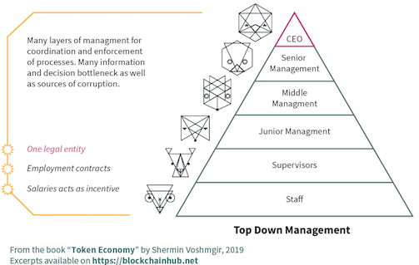
Blockchain
TRADITIONAL ORGANIZATIONS

Slide 10
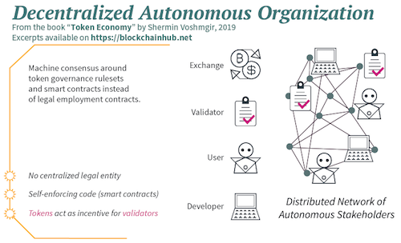
Blockchain
DAO

Slide 11
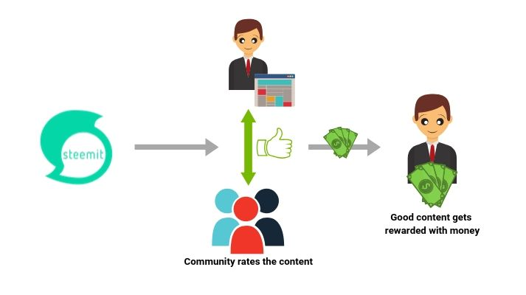
Blockchain
EXAMPLE

Slide 12
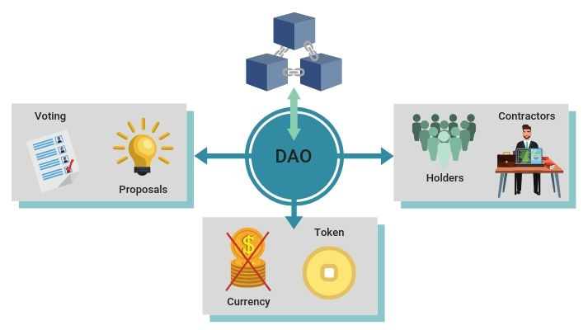
Blockchain
EXAMPLE

Slide 13
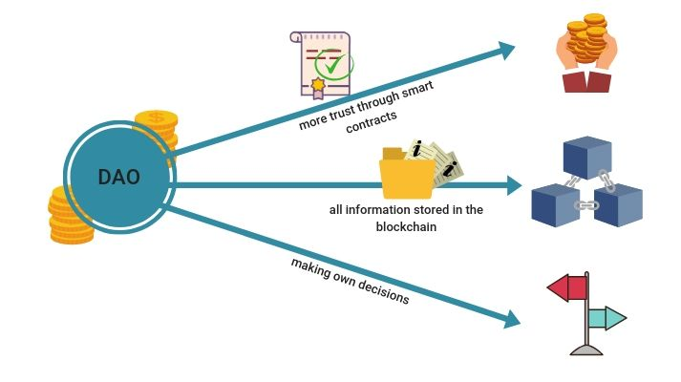
Blockchain
ADVANTAGEOUS

Slide 14
Blockchain
DISADVANTAGEOUS
A disputed point is trust.
People develop smart contracts.
Therefore, you can have errors.
We do have to trust them to do their job correctly.
One mistake can lead to the failure of the system.
Thus, the whole trust lies in the code.

Slide 15
Blockchain
SUPPLEMENTARY READINGS
www.cryptokitties.com
https://dappbuilder.io/

Slide 16
THANK YOU
Prof.Sunitha R
Department of Computer Science and Engineering
sunithar@pes.edu

